Slide 1
Homework 5

Slide 2
Homework 5
Poster for Final Project
Introduction
Method
Result
Reference
…
Font size
Max: 46
Font Type:
English: Time New Roman
中文: 標楷體

Slide 3
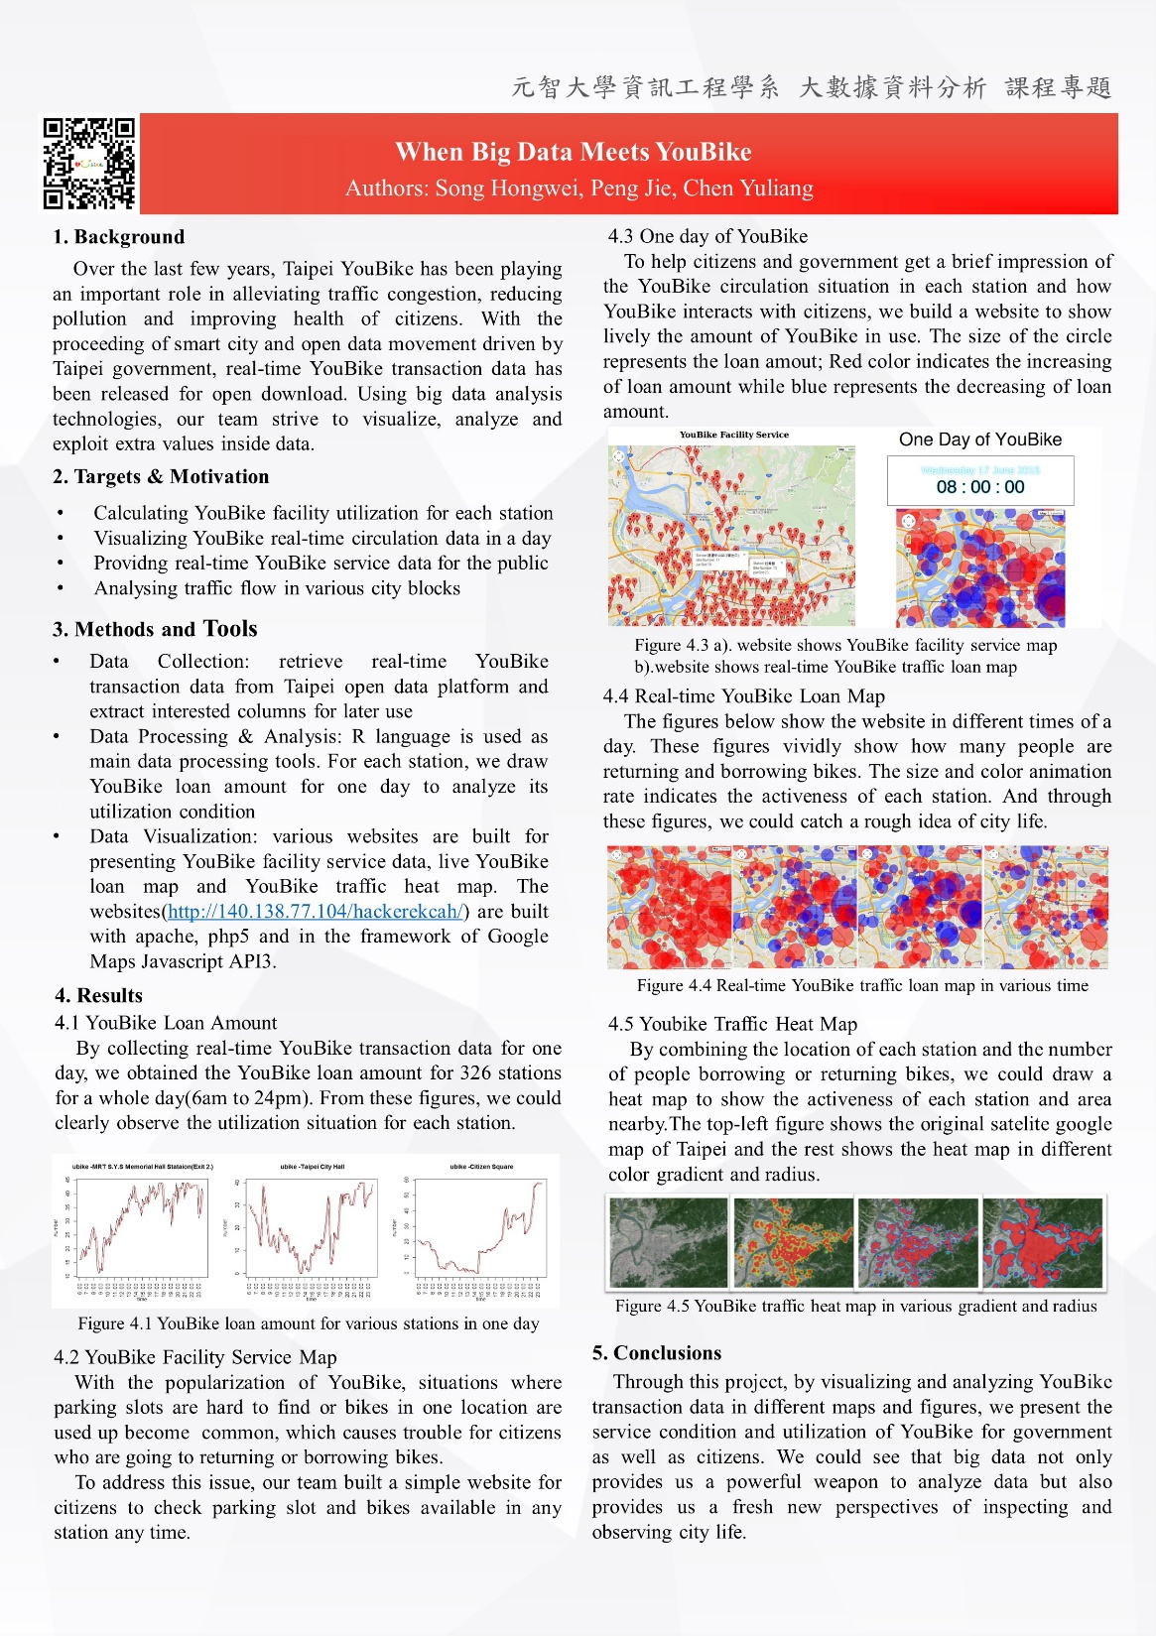
Example

Slide 4
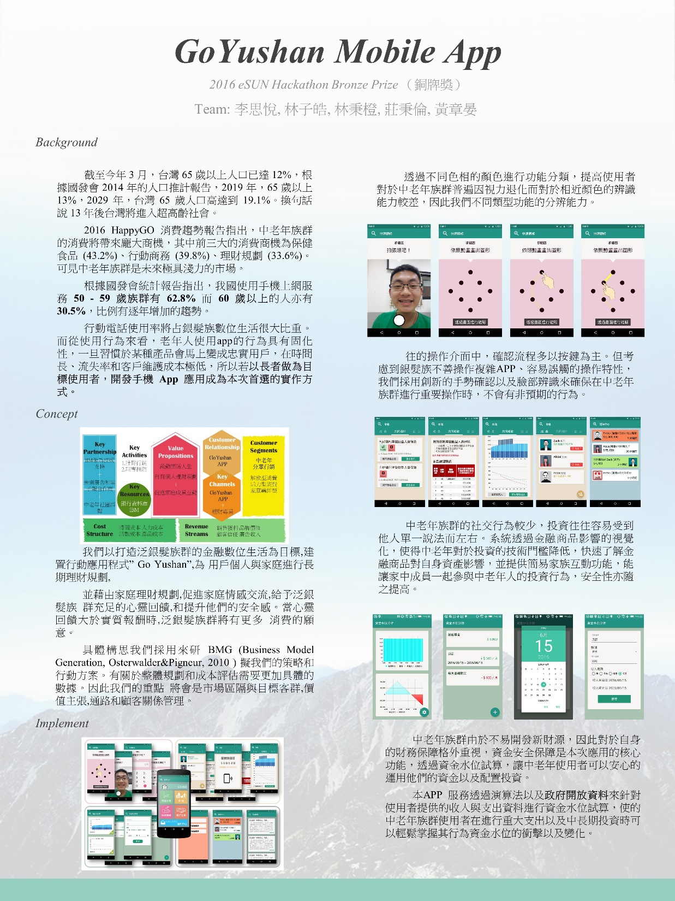
Example

Slide 5
Homework 5
Deadline
2022/06/20 23:59
Submit
Portal
Filename (SID_hw5.pptx)

